Slide 1

Spring Data JPA, Hibernate
INCONCEPT LABS LEARNING SERIES

Slide 2
Agenda
JPA
Hibernate/ Spring Data JPA
Data modeling approaches
Mapping/Loading types
n + 1 Issue

Slide 3
Java Persistence API (JPA)
The Java Persistence API (JPA) is the Java standard for mapping Java objects to a relational database. Mapping Java objects to database tables and vice versa is called Object-relational mapping (ORM). The Java Persistence API (JPA) is one possible approach to ORM.
Implementations.
Hibernate
EclipseLink
Apache Open Jpa

Slide 4
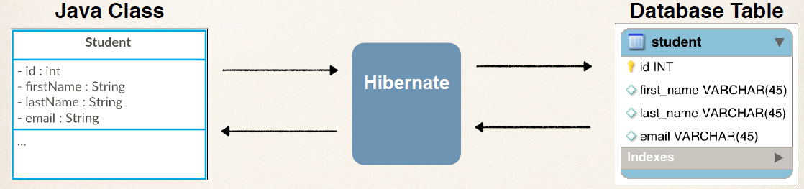
Hibernate framework
Hibernate acts as an additional layer on top of JDBC and enables you to implement a database-independent persistence layer. It provides an object-relational mapping implementation that maps your database records to Java objects and generates the required SQL statements to replicate all operations to the database.

Slide 5
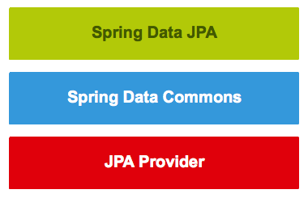
Spring Data JPA
Spring Data is a part of Spring Framework. The goal of Spring Data repository abstraction is to significantly reduce the amount of boilerplate code required to implement data access layers for various persistence stores.Spring Data JPA is not a JPA provider. It is a library/framework that adds an extra layer of abstraction on the top of our JPA provider (like Hibernate).
provides support for creating JPA repositories by extending the Spring Data repository interfaces.
provides the infrastructure that is shared by the datastore-specific Spring Data projects.
(like hibernate) implements the Java Persistence API.

Slide 6
How to use Java class as DB model
Important annotations to know
@Entity : Adding it on Model it will be treated as Entity.
@Table : Model will be mapped to database table
@Id : Specifies the primary key of an entity
@GenerateValue : It has four strategy to generate Id Value. We have to choose any one of the given value or we can add custom strategy.

Slide 7
Model first approach
Model-First basically means “working on a visual diagram and letting the ORM framework create/update the rest accordingly”:
Such approach has the following benefits:
We’ll be able to create the Database schema and the class diagram as a whole using a visual design tool, which can be great when the data structure is quite big
Whenever the Database changes, the model can be updated accordingly, without data loss
Yet also the downsides below:
The diagram-driven, auto-generated SQL scripts can lead to data loss in case of updates. An easy workaround for that will be generating the scripts on disk and manually modify them, which will require decent SQL knowledge.
Dealing with the diagram can be tricky, especially if we want to have precise control over our Model classes; we won’t always be able to get what we want, as the actual source code will be auto-generated by a tool

Slide 8
Database first approach
Database-First will mean “building the Database and letting Entity ORM create/update the rest accordingly”:
Here are the pros of this alternative approach:
If we have an already-existing Database in place, this will most likely be the way to go as it will spare us the need to recreate it
Risk of data loss will be kept to a minimum, because any change or update will be always performed on the Database
And here are the cons:
Manually updating the Database can be tricky if we’re dealing with clusters, multiple instances, or a number of development/testing/production environment, as we will have to manually keep them in sync instead than relying upon code-driven updates/migrations or auto-generated SQL scripts
We will have even less control over the autogenerated Model classes (and their source code) than using Model-First approach; it will require an extensive knowledge over ORM framework conventions and standards, otherwise we’ll often struggle to get what we want

Slide 9
Code first approach
Code-First means writing the Data Model entity classes we’ll be using within our project and let ORM framework generate the Database accordingly:
The Code-First approach comes with the following benefits:
No need for diagrams and visual tools whatsoever, which can be great for small-to-medium size projects as it will save us a lot of time
A fluent code API that allows the developer to follow a Convention over Configuration approach, to handle the most common scenarios, while also giving him the chance to switch to custom, attribute-based implementation overrides whenever he needs to customize the Database mapping
Yet it also has these downsides:
A good knowledge of the ORM programming language and convention
Maintaining the Database can be tricky sometimes as well as handling updates without suffering data loss;

Slide 10

JPQL
JPQL is a powerful query language that allows you to define database queries based on your entity model. Its structure and syntax are very similar to SQL. JPQL uses the entity object model instead of database tables to define a query.

Slide 11
Mapping Types
@OneToOne — it represents the one to one relationship between two tables.
@OneToMany/@ManyToOne — it represents the one to many relationship between two tables.
@ManyToMany — it represents the many to many relationship between two tables.

Slide 12
Eager/Lazy Loading
Eager Loading is a design pattern in which data initialization occurs on the spot
Lazy Loading is a design pattern which is used to defer initialization of an object as long as it's possible
Loading types for mappings.
@OneToMany - Lazy
@ManyToMany - Lazy
@OneToOne - Eager
@ManyToOne - Eager

Slide 13
N+1 Issue
The N+1 query problem happens when the data access framework executed N additional SQL statements to fetch the same data that could have been retrieved when executing the primary SQL query.
Unnecessary Eager loading can cause n + 1 issue (Test on User entity)
Always use Joins to avoid over-querying
Let’s go with examples

